Slide 1
Understanding transition of schizophrenia patients from eeg analysis
K M Tawsik Jawad

Slide 2
Eeg Subjects and paradigm types
Baseline Sessions: 640
3 Month follow up: 301
EEG data were sampled at 1000 Hz for patients for a rough duration of 53 minutes at baselines and shorter durations at follow-ups.
64 electrodes were placed in frontal, parietal, occipital regions of the brain.
EEG paradigms were: Combined Visual Oddball (VOD) with Mismatch Negativity (MMN)
Auditory Oddball (AOD) Auditory Steady-State Response (ASSR) Resting-State w/ Eyes Open Resting-State w/ Eyes Closed

Slide 3
Analytical measures (PSD)
Average Power Spectral Density (PSD) calculation and analysis for 640 subjects across 64 channels.
PSD calculation by applying Welch method: Using a sliding window approach on the time domain signals to calculate the Fast Fourier Transform (FFT) at each segment.
Squaring the f(x) at each segment x and dividing by length of that segment would give us the PSD value.
We also consider U which is a normalizing factor derived for the Hann window function required for applying the Welch method.

Slide 4
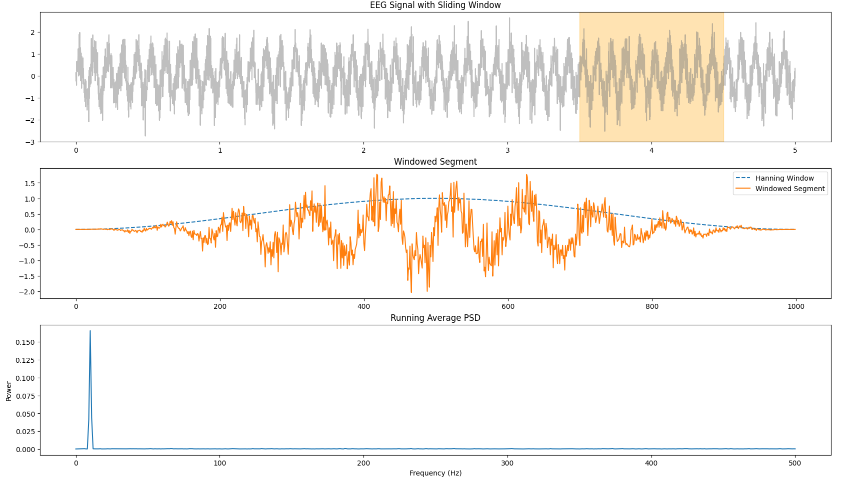
General DEMO of welch method

Slide 5
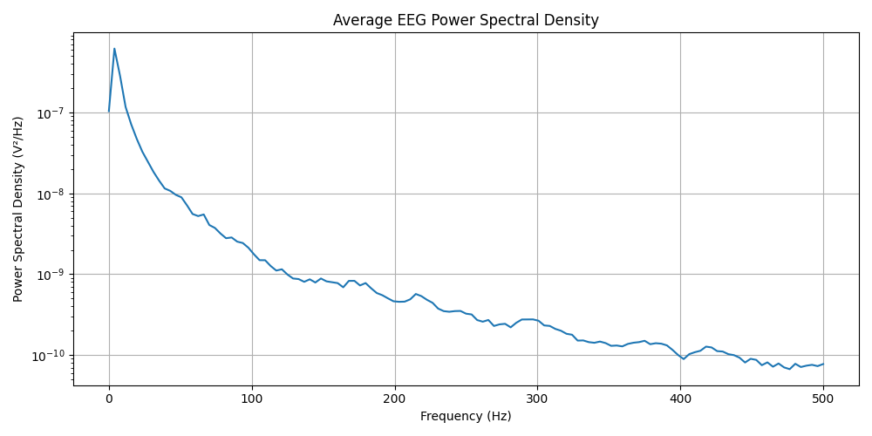
Power spectral density (PSD) Graph

Slide 6
Time frequency analysis (WAVELETS)
So far, we have frequency domain PSD to work with, but it does not tell us when the power jumps or comes down during an EEG.
We are losing temporal information, which is critical to understand the cognitive declines or improvements for the SCZ subjects or Healthy controls.
We need a way to visualize how the temporal dynamics are shifting within the 5 frequency bands we are interested in.
To understand the within subject variability of the cognitive processes, we would analyze the time frequency heatmaps of the same subject in different sessions.

Slide 7
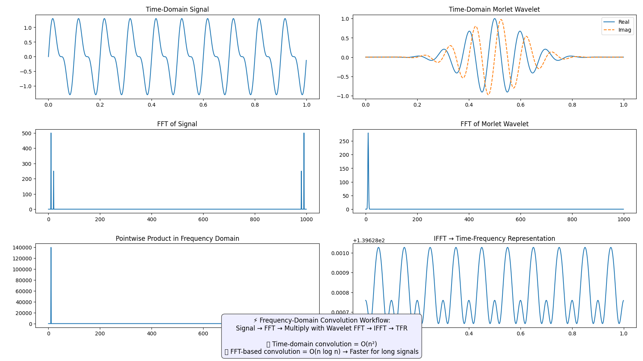
Working mechanism of the morlet wavelet

Slide 8
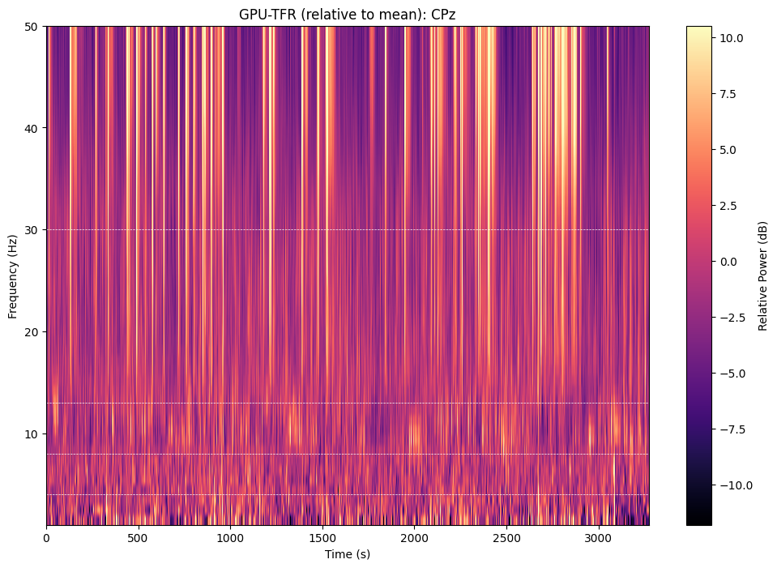
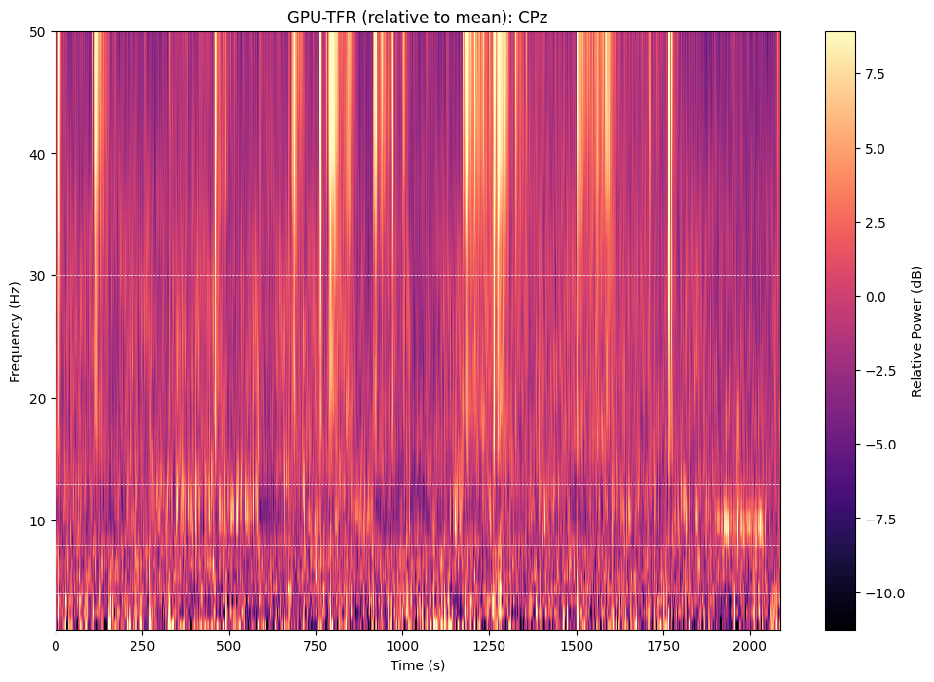
Subject heatmaps of baseline and follow up
Baseline
Follow up

